Slide 1
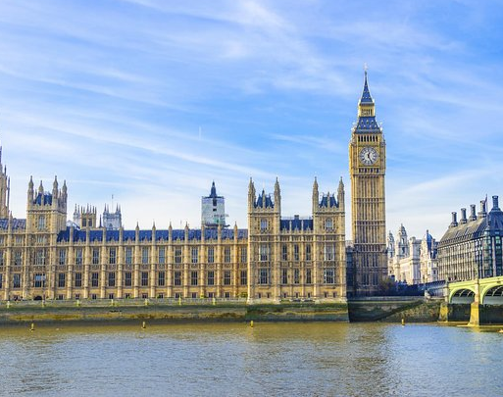
Westminster Shorter Catechism
Questions 27 - 28
March 28, 2021
Calvary OPC, La Mirada, CA

Slide 2
HEAVEN
EARTH
CHRIST
Humiliation
Exaltation

Slide 3
Question #27
Q. Wherein did Christ's humiliation consists?
A. Christ's humiliation consisted in his being born, and that in a low condition, made under the law, undergoing the miseries of this life, the wrath of God, and the cursed death of the cross, in being buried, and continuing under the power of death for a time.

Slide 4
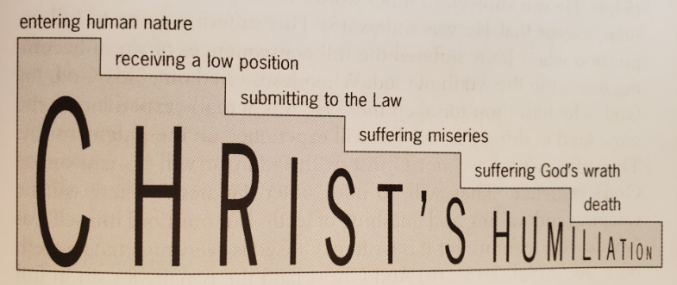

Slide 5
Entering human nature
"And she brought forth her firstborn Son, and wrapped Him in swaddling cloths, and laid Him in a manger, because there was no room for them in the inn." (Luke 2:7)
"You have made him a little lower than the angels" (Psalm 8:5 <=> Hebrews 2:7)
Incarnation
DIVINE NATURE
HUMAN NATURE
eternity past
future eternity

Slide 6
'Kenosis'
"but made Himself of no reputation, taking the form of a bondservant, and coming in the likeness of men." (Phil. 2:7)
ekenosev: emptied (according to some translations)
Jesus did not empty or subtract from Himself of His divine attributes
Rather, he took to Himself a true body, a human nature
There was no change in His divine nature
"Remaining what He was, He became what He was not"
We did not choose to be born, but Jesus did all this voluntarily

Slide 7
Receiving a low position
Jesus Christ was born into a poor family (remember last week's sermon!)
He had an ordinary, menial occupation as a carpenter
Roman soldiers occupied Israel at the time of His birth
Even when He could have become king, He did not
"Therefore when Jesus perceived that they were about to come and take Him by force to make Him king, He departed again to the mountain by Himself alone." (John 6:15)
His life was meant for something else

Slide 8
Submitting to the Law
This is Jesus' active obedience, keeping the Law on our behalf
He was tempted just like us, because He was a man, but never knew sin
"Do not think that I came to destroy the Law or the Prophets. I did not come to destroy but to fulfill." (Matthew 5:17)
Christ's righteousness is ours; the Father looks upon us as He would look upon Jesus

Slide 9
Suffering miseries
Jesus was a real man: he knew hunger, pain, sorrow, poverty, was unjustly hated, ridiculed, scorned, mocked, and even killed...
Jesus fully knew what it was like to be human, like you or me
"For we do not have a High Priest who cannot sympathize with our weaknesses, but was in all points tempted as we are, yet without sin." (Hebrews 4:15)
"Surely He has borne our griefs And carried our sorrows; Yet we esteemed Him stricken, Smitten by God, and afflicted" (Isaiah 53:4)
"And you will be hated by all for My name’s sake. But he who endures to the end will be saved." (Matthew 10:22)

Slide 10
Suffering God's wrath and death
This is Christ's passive obedience
"And being found in appearance as a man, He humbled Himself and became obedient to the point of death, even the death of the cross." (Philippians 2:8)
"For He made Him who knew no sin to be sin for us, that we might become the righteousness of God in Him." (2Corinthians 5:21)

Slide 11
And descended into hell...?
Q: Did Jesus descend into hell according to the Apostles' creed?
"So when Jesus had received the sour wine, He said, “It is finished!” And bowing His head, He gave up His spirit." (John 19:30)
"And when Jesus had cried out with a loud voice, He said, 'Father, into Your hands I commit My spirit.' Having said this, He breathed His last." (Luke 23:46)
Jesus suffered the torments of separation from the Father on the cross
something those in hell will experience for all eternity...

Slide 12
Question #27
Q. Wherein consisteth Christ's exaltation?
A. Christ's exaltation consisteth in his rising again from the dead on the third day, in ascending up into heaven, in sitting at the right hand of God the Father, and in coming to judge the world at the last day.

Slide 13
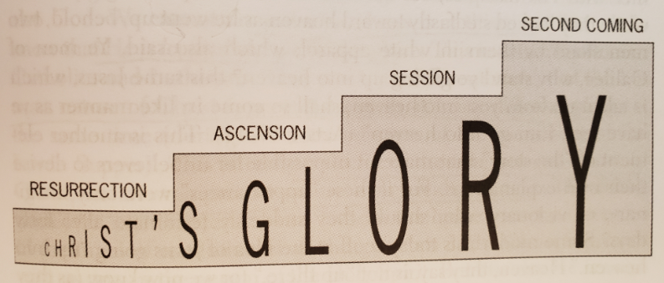

Slide 14
Bodily resurrection
"whom God raised up, having loosed the pains of death, because it was not possible that He should be held by it." (Acts 2:24)
"Behold My hands and My feet, that it is I Myself. Handle Me and see, for a spirit does not have flesh and bones as you see I have" (Luke 24:39)
Q: Did the disciples falsely convince themselves of the resurrection?
Q: Did the disciples knowingly lie about it?

Slide 15
The Resurrection
"After that He was seen by over five hundred brethren at once, of whom the greater part remain to the present, but some have fallen asleep." (1Corinthians 15:6)
two witnesses are enough to record a historical event
500 people of all different personality types
Jesus rose from the dead, and since we all are in Him, so shall we also rise from the dead in glorified bodies
same body, same identity
different in quality
sinful nature, bodily deformities, illnesses all taken away

Slide 16
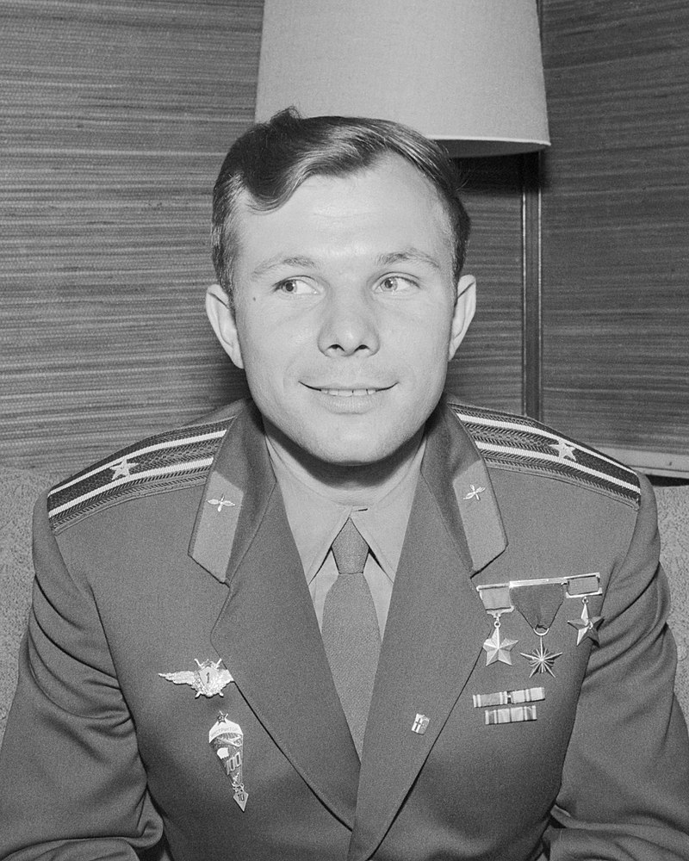
Ascended into heaven
"Men of Galilee, why do you stand gazing up into heaven? This same Jesus, who was taken up from you into heaven, will so come in like manner as you saw Him go into heaven." (Acts 1:11)
Q: where is Jesus now?
Yuri Gagarin: "I flew into space but didn't see God"
"I know a man in Christ who fourteen years ago—
whether in the body I do not know, or whether out of
the body I do not know, God knows—such a one was
caught up to the third heaven." (2Corinthians 12:2)

Slide 17
Sits at the right hand of the Father
"which He worked in Christ when He raised Him from the dead and seated Him at His right hand in the heavenly places" (Ephesians 1:20)
This is a figurative description, not a physical one: Jesus sat down at a place of honor.
"Therefore God also has highly exalted Him and given Him the name which is above every name, that at the name of Jesus every knee should bow, of those in heaven, and of those on earth, and of those under the earth" (Phil. 2:9-10) [Jesus is God]
Jesus also intercedes for us at the right hand of the Father (Hebrews 7:25)

Slide 18
The second coming
Parousia: presence, visitation
"...will so come in like manner as you saw Him go into heaven." (Acts 1:11)
"The enemy who sowed them is the devil, the harvest is the end of the age, and the reapers are the angels." (Matthew 13:37-43)
Contra Roman Catholicism: Roman Catholic priests believe they can re-create Jesus' body and soul in the host during the Mass
Contra dispensationalism: Jesus comes back at the end of this age
not once before the tribulation and then again on Judgment Day

Slide 19
The dispensations of human history
the 'great parenthesis'
Dispensationalism
age of innocence
eternal state
rapture
the Fall
Judgement
the LAW
church age (grace)
millennium
Q: Do we also believe in dispensations? How many are there?
Covenant theology
“I saw Satan fall like lightning from heaven." (Luke 10:18)
either in this age or in the age to come. (Mt. 12:32)
Therefore as the tares are gathered and burned in the fire, so it will be at the end of this age. (Mt. 13:40)
Garden of Eden
eternal state
the Fall
He laid hold of the dragon, that serpent of old, who is the Devil and Satan, and bound him for a thousand years (Rev. 20:2)
no rapture
Judgement
millennium
church age

Slide 20
When will Jesus come again?
"But of that day and hour no one knows, not even the angels of heaven, but My Father only." (Matthew 24:36)
"It is not for you to know times or seasons which the Father has put in His own authority." (Acts 1:7)
Q: Why is it important that we not know when Jesus will come again?

Slide 21
The second coming
The second coming will be 1) sudden, 2) public, 3) all shall see Him, and 4) He shall judge the living and the dead
"For when they say, 'Peace and safety!' then sudden destruction comes upon them, as labor pains upon a pregnant woman. And they shall not escape. But you, brethren, are not in darkness, so that this Day should overtake you as a thief. " (1Thessalonians 5:3-4)
Q: What Old Testament precedent do we have for Judgement Day?
Read Matthew 13:37-44

Slide 22
The rapture
Q: Will there be a rapture? Why or why not?
"But I do not want you to be ignorant, brethren, concerning those who have fallen asleep, lest you sorrow as others who have no hope. For if we believe that Jesus died and rose again, even so God will bring with Him those who sleep in Jesus. For this we say to you by the word of the Lord, that we who are alive and remain until the coming of the Lord will by no means precede those who are asleep. For the Lord Himself will descend from heaven with a shout, with the voice of an archangel, and with the trumpet of God. And the dead in Christ will rise first. Then we who are alive and remain shall be caught up together with them in the clouds to meet the Lord in the air. And thus we shall always be with the Lord." (1Thessalonians 4:13-16)

Slide 23
We shall also partake
" Do you not know that the saints will judge the world? And if the world will be judged by you, are you unworthy to judge the smallest matters? Do you not know that we shall judge angels?" (1Corinthians 6:2-3)
"If we endure, we shall also reign with Him." (2Timothy 2:12)
"and if children, then heirs—heirs of God and joint heirs with Christ, if indeed we suffer with Him, that we may also be glorified together." (Romans 8:17)
Be humble and live worthily so you can also take part in this glory

Slide 24
Weekly Bible verse
"For we do not have a High Priest who cannot sympathize with our weaknesses, but was in all points tempted as we are, yet without sin." (Hebrews 4:15)

Slide 25
R. C. Sproul on the rapture
ligonier.org/learn/series/last_days_according_to_jesus/the-rapture

